Slide 1
Data 100 Lecture 4: Data Cleaning & Exploratory Data Analysis
?
Slides by:
Joseph E. Gonzalez, Deb Nolan, Joe Hellerstein & Fernando Perez
jegonzal@berkeley.edu
deborah_nolan@berkeley.edu
hellerstein@berkeley.edu
Fernando.perez@Berkeley.edu

Slide 2
Last Week
Jupyter Notebooks
https://www.nbcnews.com/news/world/giant-pandas-are-no-longer-endangered-n643336

Slide 3
Pandas and Jupyter Notebooks
Reviewed Jupyter Notebook Environment
Introduced DataFrame concepts
Series: A named column of data with an index
Indexes: The mapping from keys to rows
DataFrame: collection of series with common index
Dataframe access methods
Filtering on predicates and slicing
df.loc: location by index label
df.iloc: location by integer address
groupby & pivot (we will review these again today)

Slide 4

Today
Box of Data

Slide 5
Congratulations!
You have collected or been given a box of data?
Box of Data
What do you do next?

Slide 6
Question & Problem Formulation
?
Data Acquisition
Prediction and Inference
Exploratory Data Analysis

Slide 7
Question & Problem Formulation
?
Topics For Lecture Today
Data Acquisition
Understanding the Data
Data Cleaning
Exploratory Data Analysis (EDA)
Basic data visualization
Common Data Anomalies
… and how to fix them
Prediction and Inference
Exploratory Data Analysis

Slide 8
Data Cleaning
Exploratory Data
Analysis
… the infinite loop of data science.

Slide 9
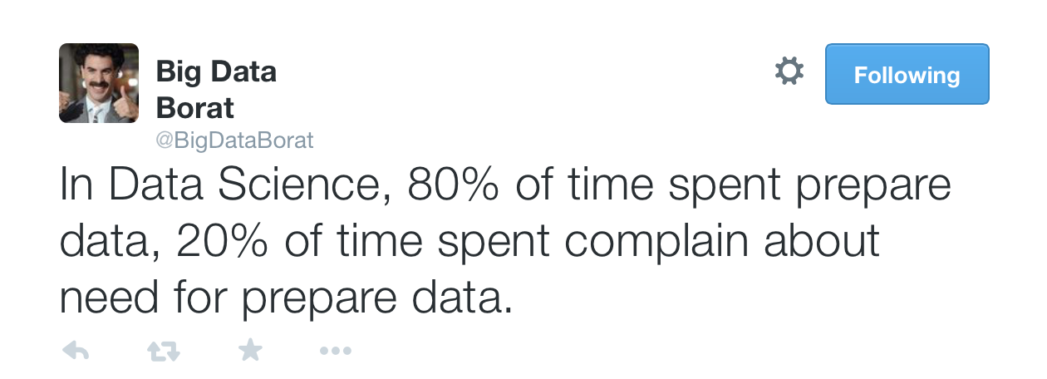
Data Cleaning
The process of transforming raw data to facilitate subsequent analysis
Data cleaning often addresses
structure / formatting
missing or corrupted values
unit conversion
encoding text as numbers
…
Sadly data cleaning is a big part of data science…

Slide 10
Data Cleaning
The process of transforming raw data to facilitate subsequent analysis
Data cleaning often addresses
structure / formatting
missing or corrupted values
unit conversion
encoding text as numbers
…
Sadly data cleaning is a big part of data science…

Slide 11
Data Cleaning
Exploratory Data Analysis
… the infinite loop of data science.

Slide 12
Exploratory Data Analysis
(EDA)
“Getting to know the data”
The process of transforming, visualizing, and summarizing data to:
Build/confirm understanding of the data and its provenance
Identify and address potential issues in the data
Inform the subsequent analysis
discover potential hypothesis … (be careful)
EDA is an open ended analysis
Be willing to find something surprising

Slide 13

John Tukey
Princeton Mathematician & Statistician
Introduced
Fast Fourier Transform
“Bit” : binary digit
Exploratory Data Analysis
Early Data Scientist
Data Analysis & Statistics, Tukey 1965
Image from LIFE Magazine
Notes:
John Tukey, Princeton mathematician and statistician, inventor of the Fast Fourier Transform and father of Exploratory Data Analysis. Also coined the word “bit”.
Emphasis courtesy Jeff Heer, U. Washington

Slide 14
EDA is like detective work
“Exploratory data analysis is an attitude, a state of flexibility, a willingness to look for those things that we believe are not there, as well as those that we believe to be there.”
Data Analysis & Statistics, Tukey 1965
Image from LIFE Magazine
Notes:
Contrast to confirmatory data analysis (statistical hypothesis testing)

Slide 15
50 Years of Data Science
D. Donoho, 2017
“More than 50 years ago, John Tukey called for a reformation of academic statistics. In ‘The Future of Data Analysis’, he pointed to the existence of an as-yet unrecognized science, whose subject of interest was learning from data, or ‘data analysis’…
50 Years of Data Science – D. Donoho
https://www.tandfonline.com/doi/abs/10.1080/10618600.2017.1384734
Notes:
Contrast to confirmatory data analysis (statistical hypothesis testing)

Slide 16
What should we look for?

Slide 17
Key Data Properties to Consider in EDA
Structure -- the “shape” of a data file
Granularity -- how fine/coarse is each datum
Scope -- how (in)complete is the data
Temporality -- how is the data situated in time
Faithfulness -- how well does the data capture “reality”

Slide 18
Key Data Properties to Consider in EDA
Structure -- the “shape” of a data file
Granularity -- how fine/coarse is each datum
Scope -- how (in)complete is the data
Temporality -- how is the data situated in time
Faithfulness -- how well does the data capture “reality”

Slide 19
Rectangular Data
Fields/Attributes/ Features/Columns
We prefer rectangular data for data analysis (why?)
Regular structures are easy manipulate and analyze
A big part of data cleaning is about transforming data to be more rectangular
Two kinds of rectangular data: Tables and Matrices
(what are the differences?)
Tables (a.k.a. data-frames in R/Python and relations in SQL)
Named columns with different types
Manipulated using data transformation languages (map, filter, group by, join, …)
Matrices
Numeric data of the same type
Manipulated using linear algebra
Records/Rows

Slide 20
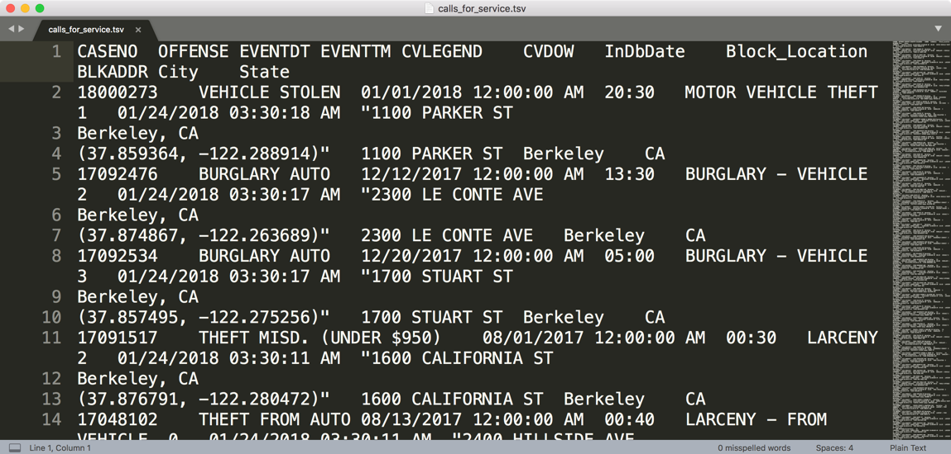
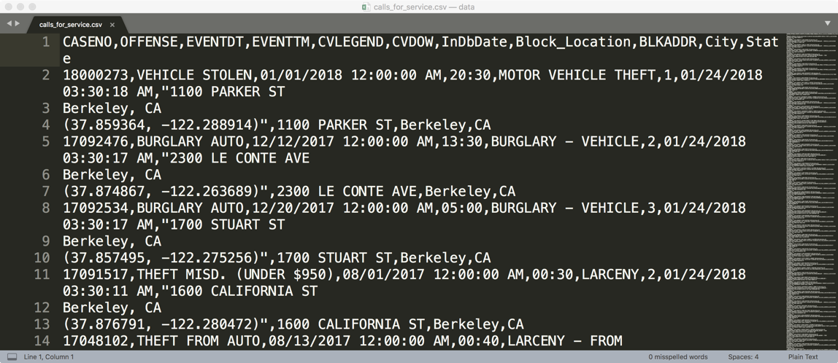
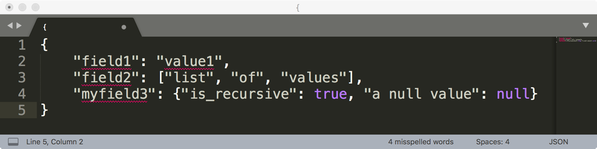
How are these data files formatted?
TSV
Tab separated values
Which is the best?
CSV
Comma separated values
JSON

Slide 21
Comma and Tab Separated Values Files
Tabular data where
records are delimited by a newline: “\n”, “\r\n”
Fields are delimited by ‘,’ (comma) or ‘\t’ (tab)
Very Common!
Issues?
Commas, tabs in records
Quoting
…

Slide 22
JavaScript Object Notation (JSON)
Widely used file format for nested data
Natural maps to python dictionaries (many tools for loading)
Strict formatting ”quoting” addresses some issues in CSV/TSV
Issues
Each record can have different fields
Nesting means records can contain records → complicated

Slide 23
XML (another kind of nested data)
<catalog>
<plant type='a'>
<common>Bloodroot</common>
<botanical>Sanguinaria canadensis</botanical>
<zone>4</zone>
<light>Mostly Shady</light>
<price>2.44</price>
<availability>03/15/2006</availability>
<description>
<color>white</color>
<petals>true</petals>
</description>
<indoor>true</indoor>
</plant>
…
</catalog>
Nested structure
We will study XML later in the class
Notes:
anything in brackets is markup; only 4 pieces of information

Slide 24
Log data
Is this a csv file? tsv?
JSON/XML?
169.237.46.168 - - [26/Jan/2014:10:47:58 -0800] "GET /stat141/Winter04 HTTP/1.1" 301 328 "http://anson.ucdavis.edu/courses/" "Mozilla/4.0 (compatible; MSIE 6.0; Windows NT 5.0; .NET CLR 1.1.4322)”
169.237.6.168 - - [8/Jan/2014:10:47:58 -0800] "GET /stat141/Winter04/ HTTP/1.1" 200 2585 "http://anson.ucdavis.edu/courses/" "Mozilla/4.0 (compatible; MSIE 6.0; Windows NT 5.0; .NET CLR 1.1.4322)"

Slide 25
Data can be split across files and reference other data.

Slide 26
Structure: Keys
Purchases.csv
OrderNum | ProdID | Quantity
1 | 42 | 3
1 | 999 | 2
2 | 42 | 1
Often data will reference other pieces of data
Primary key: the column or set of columns in a table that determine the values of the remaining columns
Primary keys are unique
Examples: SSN, ProductIDs, …
Foreign keys: the column or sets of columns that reference primary keys in other tables.
Foreign Key
Orders.csv
OrderNum | CustID | Date
1 | 171345 | 8/21/2017
2 | 281139 | 8/30/2017
Products.csv
ProdID | Cost
42 | 3.14
999 | 2.72
Primary Key
Customers.csv
CustID | Addr
171345 | Harmon..
281139 | Main ..

Slide 27
Merging/joining data across tables

Slide 28
Joining two tables
OrderNum | ProdID | Name
1 | 42 | Gum
2 | 999 | NullFood
2 | 42 | Towel
OrderId | Cust Name | Date
1 | Joe | 8/21/2017
2 | Arthur | 8/14/2017
x
Left “key”
Right “key”
OrderNum | ProdID | Name | OrderId | Cust Name | Date
1 | 42 | Gum | 1 | Joe | 8/21/2017
1 | 42 | Gum | 2 | Arthur | 8/14/2017
2 | 999 | NullFood | 1 | Joe | 8/21/2017
2 | 999 | NullFood | 2 | Arthur | 8/14/2017
2 | 42 | Towel | 1 | Joe | 8/21/2017
2 | 42 | Towel | 2 | Arthur | 8/14/2017
Drop rows that don’t match on the key

Slide 29
Joining two tables
OrderNum | ProdID | Name
1 | 42 | Gum
2 | 999 | NullFood
2 | 42 | Towel
OrderId | Cust Name | Date
1 | Joe | 8/21/2017
2 | Arthur | 8/14/2017
x
Left “key”
Right “key”
OrderNum | ProdID | Name | OrderId | Cust Name | Date
1 | 42 | Gum | 1 | Joe | 8/21/2017
1 | 42 | Gum | 2 | Arthur | 8/14/2017
2 | 999 | NullFood | 1 | Joe | 8/21/2017
2 | 999 | NullFood | 2 | Arthur | 8/14/2017
2 | 42 | Towel | 1 | Joe | 8/21/2017
2 | 42 | Towel | 2 | Arthur | 8/14/2017
Drop rows that don’t match on the key
OrderNum | ProdID | Name | OrderId | Cust Name | Date
1 | 42 | Gum | 1 | Joe | 8/21/2017
2 | 999 | NullFood | 2 | Arthur | 8/14/2017
2 | 42 | Towel | 2 | Arthur | 8/14/2017

Slide 30
Pandas Merge
Demo
https://www.popsci.com/pandas-have-cute-markings-because-their-food-supply-sucks

Slide 31
Questions to ask about Structure
Are the data in a standard format or encoding?
Tabular data: CSV, TSV, Excel, SQL
Nested data: JSON or XML
Are the data organized in “records”?
No: Can we define records by parsing the data?
Are the data nested? (records contained within records…)
Yes: Can we reasonably un-nest the data?
Does the data reference other data?
Yes: can we join/merge the data
What are the fields in each record?
How are they encoded? (e.g., strings, numbers, binary, dates …)
What is the type of the data?

Slide 32
Kinds of
Data
Note that data categorical data can also be numbers and quantitative data may be stored as strings.
Categorical Data
Quantitative Data
Numbers with meaning ratios or intervals.
Ordinal
Nominal
Examples:
Price
Quantity
Temperature
Date
…
Categories with orders but no consistent meaning if magnitudes or intervals
Categories with no
specific ordering.
Examples:
Preferences
Level of education
…
Examples:
Political Affiliation
Product Type
Cal Id
…

Slide 33
Structure: Field Types
Quantitative Data: data with meaningful differences or ratios
Continuous: weight, temperature, volume
Discrete: counts, …
Visualization: histograms and box plots
Ordinal Data: data where relative order matters
Differences between entries may not be the same
Examples:
level of education: [BS, MS, PhD]
Preferences: [Dislike, Like, Must Have]
Visualization: Bar charts (sorted)
Nominal Data: data with no numerical meaning
Examples: names, political affiliation, eye color,
It may be encoded as numbers …
Visualization: Bar charts

Slide 34
Quiz
http://bit.ly/ds100-fa18-eda
Price in dollars of a product?
(A) Quantitative, (B) Ordinal, (C) Nominal
Star Rating on Yelp?
(A) Quantitative, (B) Ordinal, (C) Nominal
Date an item was sold?
(A) Quantitative, (B) Ordinal, (C) Nominal
What is your Credit Card Number?
(A) Quantitative, (B) Ordinal, (C) Nominal
Notes:
A (quantitatie), B (ordinal but sometimes treated as quantitative), A(Quantitative), C(nominal)

Slide 35
Quiz
http://bit.ly/ds100-fa18-eda
Price in dollars of a product?
(A) Quantitative, (B) Ordinal, (C) Nominal
Star Rating on Yelp?
(A) Quantitative, (B) Ordinal, (C) Nominal
Date an item was sold?
(A) Quantitative, (B) Ordinal, (C) Nominal
What is your Credit Card Number?
(A) Quantitative, (B) Ordinal, (C) Nominal
Notes:
A (quantitatie), B (ordinal but sometimes treated as quantitative), A(Quantitative), C(nominal)

Slide 36
Key Data Properties to Consider in EDA
Structure -- the “shape” of a data file
Granularity -- how fine/coarse is each datum
Scope -- how (in)complete is the data
Temporality -- how is the data situated in time
Faithfulness -- how well does the data capture “reality”

Slide 37
Key Data Properties to Consider in EDA
Structure -- the “shape” of a data file
Granularity -- how fine/coarse is each datum
Scope -- how (in)complete is the data
Temporality -- how is the data situated in time
Faithfulness -- how well does the data capture “reality”

Slide 38
Granularity
What does each record represent?
Examples: a purchase, a person, a group of users
Do all records capture granularity at the same level?
Some data will include summaries as records
If the data are coarse how was it aggregated?
Sampling, averaging, …
What kinds of aggregation is possible/desirable?
From individual people to demographic groups?
From individual events to totals across time or regions?
Hierarchies (city/county/state, second/minute/hour/days)
Understanding and manipulating granularity can help reveal patterns.

Slide 39
Granularity and Keys
Purchases.csv
OrderNum | ProdID | Quantity
1 | 42 | 3
1 | 999 | 2
2 | 42 | 1
The primary key defines what the record represents → Granularity
What is the granularity of these example tables?
Purchases.csv: PK=(OrderNum + ProdID) ➔ Each Item in an order
Orders.csv: PK = OrderNum → an order
How might we adjust the granularity?
Aggregation: count, mean, median, var, groupby, pivot …
Orders.csv
OrderNum | CustID | Date
1 | 171345 | 8/21/2017
2 | 281139 | 8/30/2017
Products.csv
ProdID | Cost
42 | 3.14
999 | 2.72
Customers.csv
CustID | Addr
171345 | Harmon..
281139 | Main ..

Slide 40
Reviewing Group By and Pivot

Slide 41
Manipulating Granularity: Group By
Key
Data
A
A
3
3
B
B
1
1
C
C
4
4
A
A
1
1
B
B
5
5
C
C
9
9
A
A
2
2
B
B
6
6
C
C
5
5

Slide 42
Manipulating Granularity: Group By
Key
Data
A
3
A
3
A
1
B
B
1
1
A
2
C
C
4
4
A
1
B
B
5
5
C
C
9
9
A
2
B
B
6
6
C
C
5
5

Slide 43
Manipulating Granularity: Group By
Key
Data
A
3
A
3
A
1
B
1
A
2
C
4
A
1
B
1
Split into
Groups
B
5
B
5
C
9
B
6
A
2
C
4
B
6
C
9
C
5
C
5

Slide 44
Manipulating Granularity: Group By
Key
Data
A
3
A
3
Aggregate
Function
A
A
6
A
1
6
B
1
A
2
C
4
A
1
B
1
Split into
Groups
Aggregate
Function
B
B
12
B
5
B
5
12
C
9
B
6
A
2
C
4
B
6
Aggregate
Function
C
9
C
C
18
18
C
5
C
5

Slide 45
Manipulating Granularity: Group By
Key
Data
A
3
A
3
A
1
Aggregate
Function
A
6
B
1
A
2
C
4
A
6
A
1
B
1
Split into
Groups
Merge
Results
B
12
B
5
B
5
Aggregate
Function
B
12
C
18
C
9
B
6
A
2
C
4
B
6
Aggregate
Function
C
9
C
18
C
5
C
5

Slide 46
Manipulating Granularity: Pivot
Key R
Key
C
Data
A
A
U
U
3
3
B
B
V
V
1
1
C
C
U
U
4
4
A
A
V
V
1
1
B
B
U
U
5
5
C
C
V
V
9
9
A
A
U
U
2
2
B
B
V
V
6
6
D
D
U
U
5
5

Slide 47
Manipulating Granularity: Pivot
Key R
Key
C
A
U
3
Data
Aggregate
Function
A
U
5
A
U
3
A
U
2
B
V
1
Aggregate
Function
A
V
1
A
V
1
C
U
4
Aggregate
Function
B
U
5
B
U
5
A
V
1
Split into
Groups
B
V
1
Aggregate
Function
B
V
7
B
U
5
B
V
6
C
V
9
C
U
4
Aggregate
Function
C
U
4
A
U
2
C
V
9
Aggregate
Function
C
V
9
B
V
6
D
U
5
D
U
5
Aggregate
Function
D
U
5

Slide 48
Manipulating Granularity: Pivot
Key R
Key
C
A
U
3
Data
Aggregate
Function
A
U
5
A
U
5
A
U
3
A
U
2
B
V
1
Aggregate
Function
A
V
1
A
V
1
A
V
1
C
U
4
Aggregate
Function
B
U
5
B
U
5
B
U
5
A
V
1
Split into
Groups
B
V
1
Aggregate
Function
B
V
7
B
U
5
B
V
7
B
V
6
C
V
9
C
U
4
Aggregate
Function
C
U
4
C
U
4
A
U
2
Aggregate
Function
C
V
9
B
V
6
C
V
9
C
V
9
D
U
5
D
U
5
Aggregate
Function
D
U
5
D
U
5

Slide 49
Manipulating Granularity: Pivot
Key R
Key
C
A
U
3
Data
Aggregate
Function
A
U
5
A
U
3
A
U
2
B
V
1
Aggregate
Function
A
V
1
A
V
1
V
U
V
C
U
4
Aggregate
Function
B
U
5
B
U
5
U
A
1
A
5
A
V
1
Split into
Groups
B
V
1
Aggregate
Function
B
V
7
B
5
7
B
U
5
V
B
V
6
C
V
9
C
4
9
C
U
4
Aggregate
Function
C
U
4
U
D
5
A
U
2
Need to address missing values
Aggregate
Function
C
V
9
B
V
6
C
V
9
V
D
U
5
D
U
5
Aggregate
Function
D
U
5
U

Slide 50
Demo
http://abcnews.go.com/Lifestyle/silly-baby-panda-falls-flat-face-public-debut/story?id=42481478

Slide 51
Key Data Properties to Consider in EDA
Structure -- the “shape” of a data file
Granularity -- how fine/coarse is each datum
Scope -- how (in)complete is the data
Temporality -- how is the data situated in time
Faithfulness -- how well does the data capture “reality”

Slide 52
Key Data Properties to Consider in EDA
Structure -- the “shape” of a data file
Granularity -- how fine/coarse is each datum
Scope -- how (in)complete is the data
Temporality -- how is the data situated in time
Faithfulness -- how well does the data capture “reality”

Slide 53
Scope
Does my data cover my area of interest?
Example: I am interested in studying crime in California but I only have Berkeley crime data.
Is my data too expansive?
Example: I am interested in student grades for DS100 but have student grades for all statistics classes.
Solution: Filtering → Implications on sample?
If the data is a sample I may have poor coverage after filtering …
Does my data cover the right time frame?
More on this in temporality …

Slide 54
To be continued …
In the next lecture

